Slide 1
Exploring Forecasting Methods for College Graduates Unemployment Rate & Personal Saving Rate
Claude Lee
STAT 427 Final Project
Notes:
(15s)
Hello. My name is Claude, and today I will be presenting about exploring forecasting methods for college graduates unemployment rate and personal saving rate.

Slide 2
Contents
College Graduates Unemployment Rate (Seasonal)
Preliminary Graphs & Analysis
Basic Forecasting Methods & OLS Regression
STL Decomposition
Exponential Smoothing
Comparisons, Conclusion, and Final Remarks
Personal Saving Rate (Seasonally Adjusted)
Preliminary Graphs & Analysis
Basic Forecasting Methods & Exponential Smoothing
Comparisons, Conclusion, and Final Remarks
Notes:
(15s)
As shown in this slide, we will explore 4 different types of methods for college graduates unemployment rate, and 2 types for personal saving rate.

Slide 3
College Graduates Unemployment Rate (UCG)
For Bachelor’s Degree graduates with aged from 20 to 24
Monthly Data from Jan/2000 to Nov/2019 (length: 239)
Not seasonally adjusted
Source: FRED (https://fred.stlouisfed.org/series/CGBD2024#0)
Notes:
(30s)
College Graduates Unemployment Rate, which will be referred as UCG, is restricted to Bachelor’s Degree graduates whose age is in between 20 and 24. The data is a monthly data from January 2000 to November 2019 with 239 data points. It is not seasonally adjusted and it is from FRED website.

Slide 4
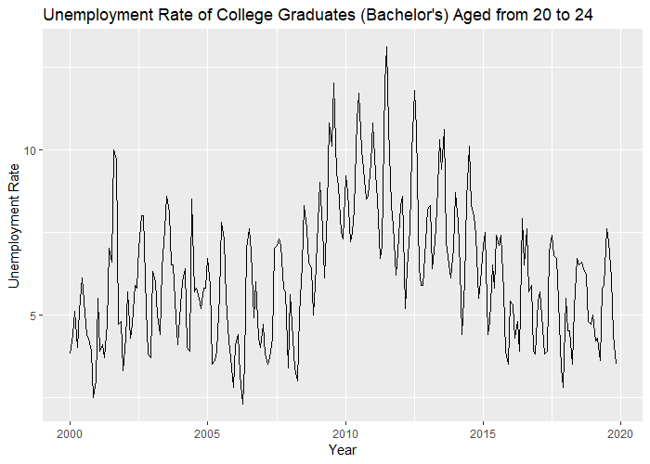
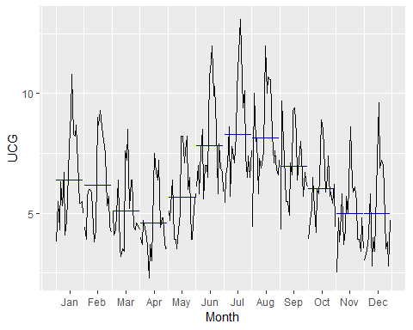
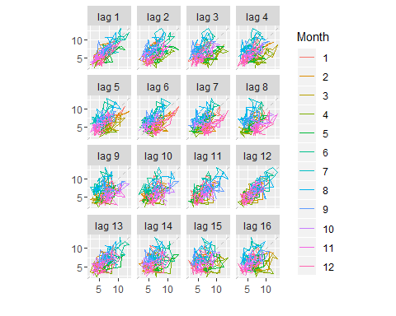
UCG a) Preliminary Graphs and Analysis
Trend
Polynomial trend
Small peak around 2004, large peak around 2012
Troughs around 2006 and 2018
Seasonality
Strong seasonal pattern
Strong autocorrelation in every 12 month
Peaks in June, July, and January
Troughs in April and November.
Roughly constant over time
Notes:
(30s)
The data shows polynomial trend with some peaks and troughs throughout the years. It has a strong seasonal trend as you can see in the lag plots that every 12 month has a strong autocorrelation. It peaks in June or July, goes down until November, goes up a little in January, goes down again until April, then it peaks back on June.

Slide 5
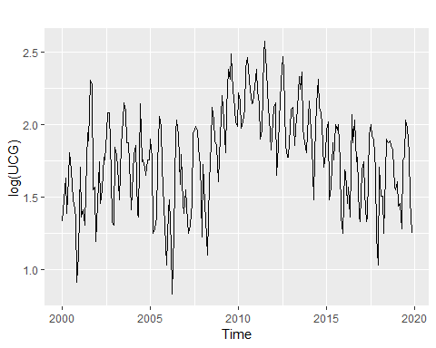
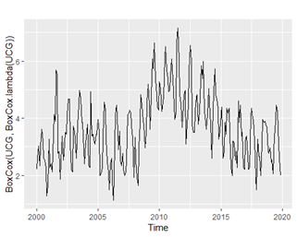
UCG a) cont. Transformation
Hard to tell “constant variance”
Transformation may not be needed
Log and auto Box-Cox transformation
Notes:
(30s)
Now, let’s examine whether transformation is needed or not. In the original time series plot on the top right, it is hard to tell whether it has a constant variance over the years. However, if you look down at the plots for log and auto Box-Cox transformed data, they do not make much of difference. Therefore, we will stick with the original time series.

Slide 6
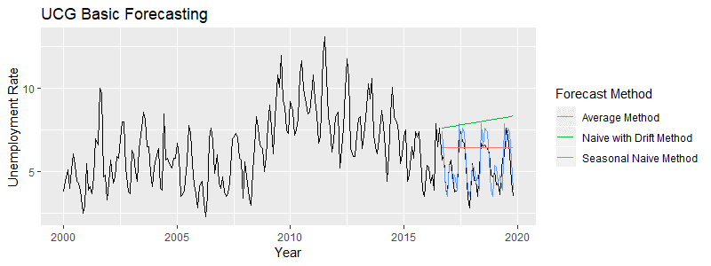
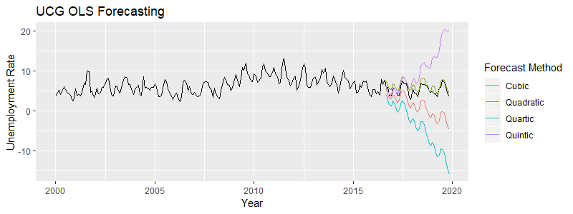
UCG b) Basic Forecasting Methods & OLS Regression
Seasonal Naïve (Blue)
By Forecast Accuracy & Residuals
Quadratic Time Trend OLS (Green)
By Forecast Accuracy & Residuals
Notes:
(30s)
In basic forecasting methods, I considered average, seasonal naïve, and drift method, and in OLS forecasting, I considered 4 different polynomial time trend. From test/training forecast accuracy and residual diagnostics, Seasonal Naïve and Quadratic Time Trended OLS performed the best for each category.

Slide 7
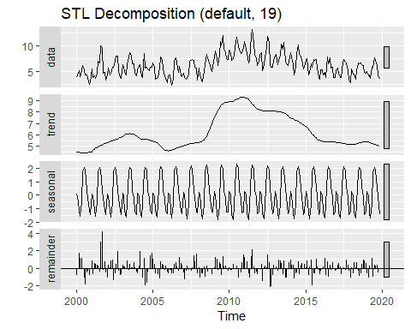
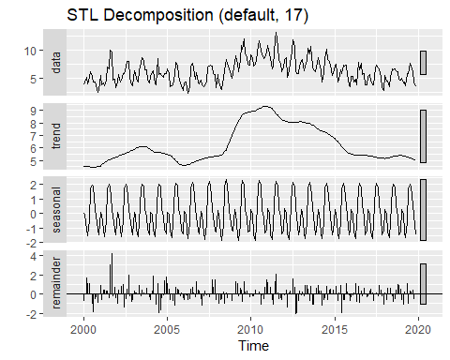

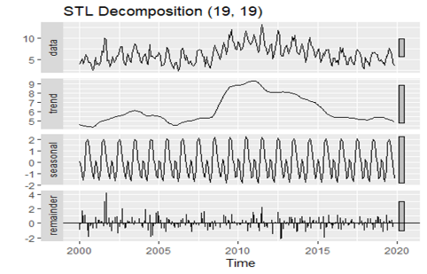
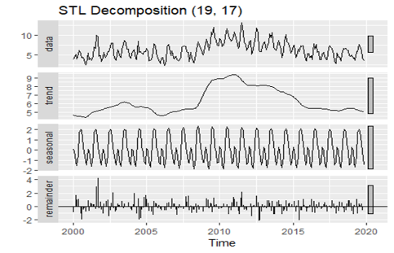
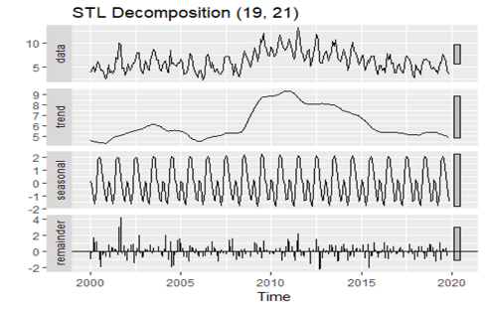
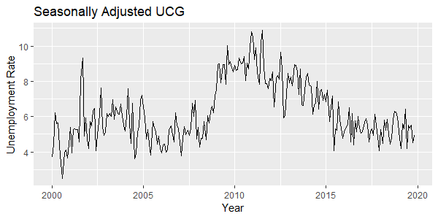


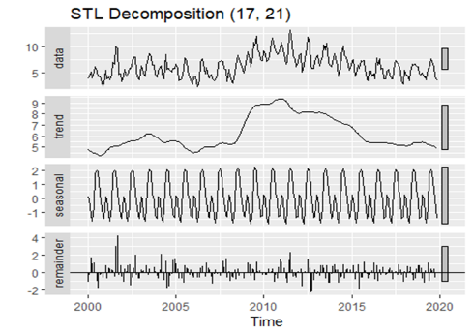


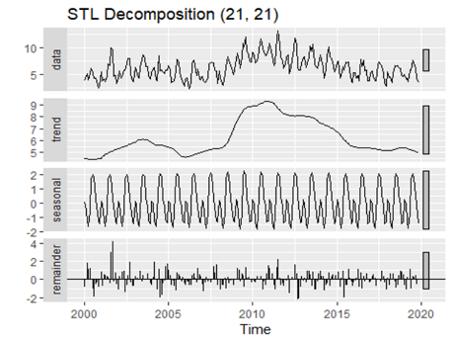
UCG c) STL Decomposition
Default Time Trend Smoother
Seasonal Trend Smoother = 19
239 pts -> 19-20 consecutive years
Notes:
(1m)
For STL decomposition method, I explored different time trend and seasonal trend smoothers around 19, which is about how much consecutive years we have in the data. Turns out to be that they do not make much of difference. Therefore, we will stick with the most basic STL decomposition, which uses default for time trend smoother and number of consecutive years for seasonal trend smoother.
As shown in the graph left bottom, note that even after taking out seasonal component, the data still had some random variability that are not quite seasonal.

Slide 8
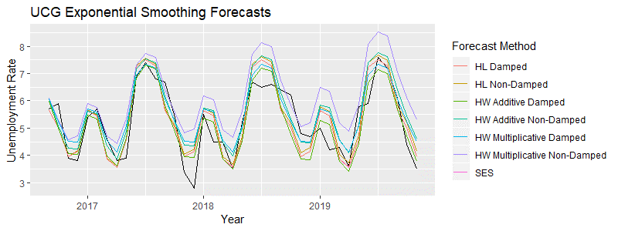
UCG d) Exponential Smoothing
Holt-Winters’ Additive Seasonality with Damped Trend (Green)
By Forecast Accuracy & Residuals
Notes:
(30s)
For exponential Smoothing, I explored Simple Exponential Smoothing, Holt’s Linear trend, and Holt-Winters’ seasonal with different tuning options. After comparing with test/training forecast accuracy and residual diagnostics, Holt-Winters’ Additive Seasonality with damped trend performed the best.

Slide 9
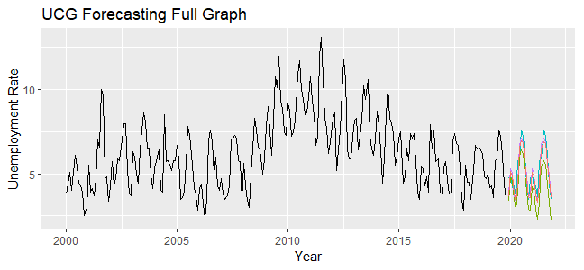
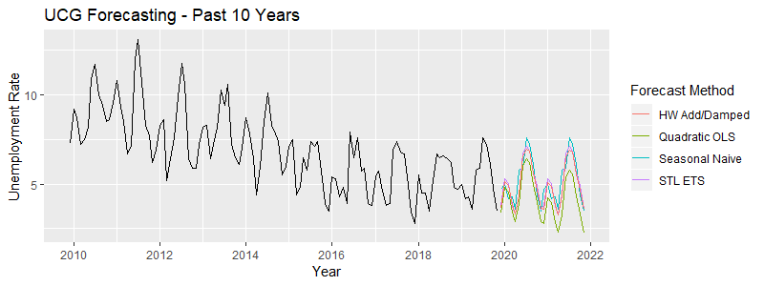
UCG Comparisons, Conclusion, and Final Remarks
Quadratic OLS: harsh decreasing trend
Seasonal Naïve: flat trend
HW Add/Damp: slightly decreasing trend with constant seasonality (Orange)
STL w/ ETS: flat trend
Many fail to identify time trend
Stagnant recent time trend
Notes:
(2m)
Now, let’s compare future forecasts of our four selected models that we chose from each of 4 types of forecasting methods. The left graph shows full dataset and the right graph shows only the past 10 years. For Quadratic OLS, the harshly decreasing trend may be underestimating the values, whereas seasonal naïve and STL with ETS forecasting returns flat trend, which are not so meaningful either. Therefore, we are left with HW add seasonality with damped trend.
As a final remark, I have observed that many of methods fail to identify time trend. I presume that this may be due to a stagnant time trend in the recent years, which would have made test set unreliable.

Slide 10
Personal Saving Rate (PSR)
Monthly Data from Jan/1959 to Oct/2019 (length: 730)
Seasonally adjusted
Source: FRED (https://fred.stlouisfed.org/series/PSAVERT)
Notes:
(20s)
For Personal Saving Rate, which will be referred as PSR, is also a monthly data from January 1959 to October 2019 with 730 data points. And it is seasonally adjusted and it is again from FRED website.

Slide 11
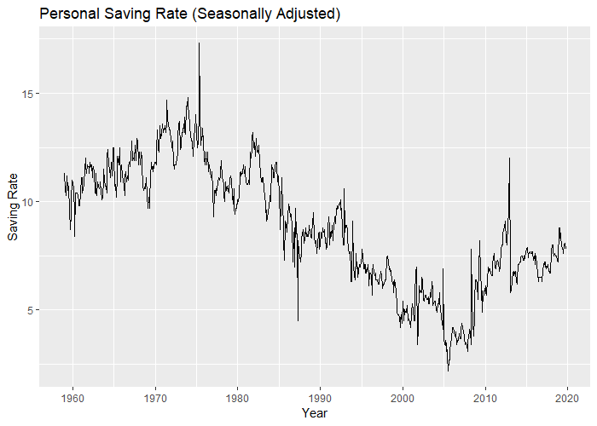
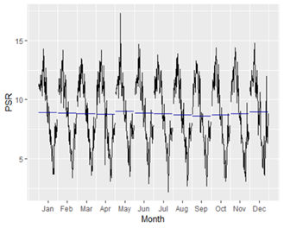
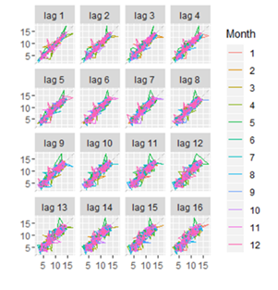
PSR a) Preliminary Graphs and Analysis
Trend
Polynomial trend
Peak around 1975
Trough around 2005
Seasonality
No seasonal pattern (since adjusted)
Notes:
(30s)
For PSR, time trend also shows polynomial trend with peak around 1975 and trough around 2005. As expected, seasonality barely exists in this data since it is already seasonally adjusted.

Slide 12

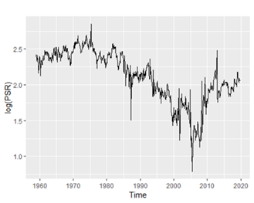
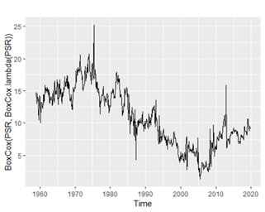
PSR a) cont. Transformation
Roughly “constant variance” except a few spikes
Transformation may not be needed
Log and auto Box-Cox transformation
Notes:
(30s)
Unlike our previous data, we can somewhat see that the data has roughly constant variance except a few spikes. The transformed data shown in the graphs below also do not show much improvements, so let’s stick with original time series.

Slide 13
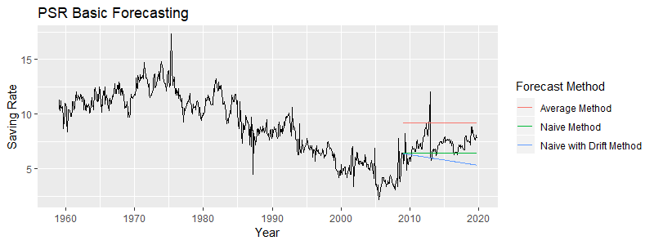
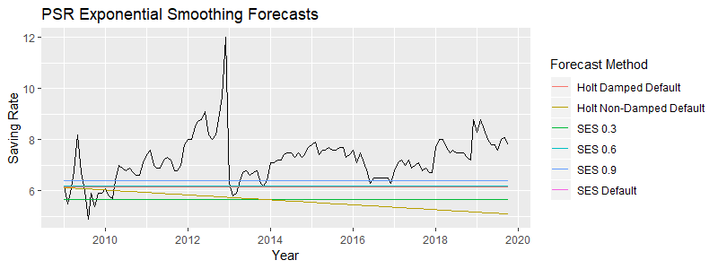
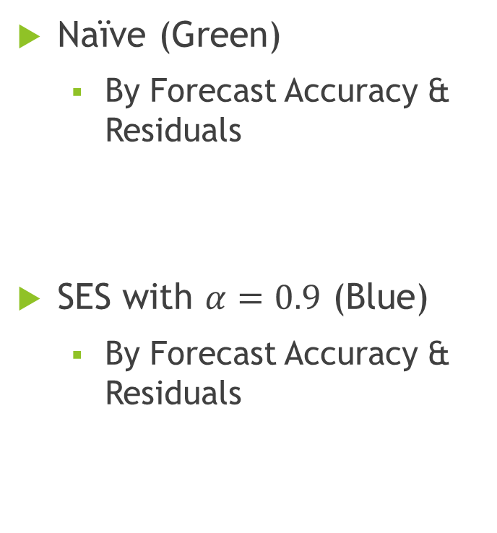
UCG b) Basic Forecasting Methods & Exponential Smoothing
Naïve (Green)
By Forecast Accuracy & Residuals
SES with $α=0.9$ (Blue)
By Forecast Accuracy & Residuals
Notes:
(30s)
This time, since the data is seasonally adjusted, I took out seasonal naïve and put naïve for Basic Forecasting methods, and excluded Holt-Winters’ seasonal method for Exponential Smoothing. Same criteria, by test/training forecast accuracy and residual diagnostics, Naïve and Simple Exponential Smoothing with alpha 0.9 performed the best in each type.

Slide 14
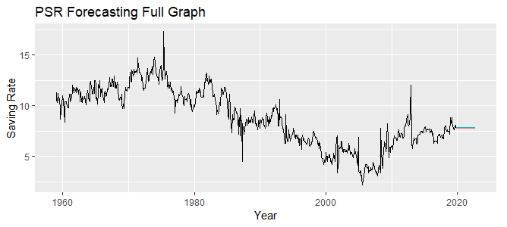
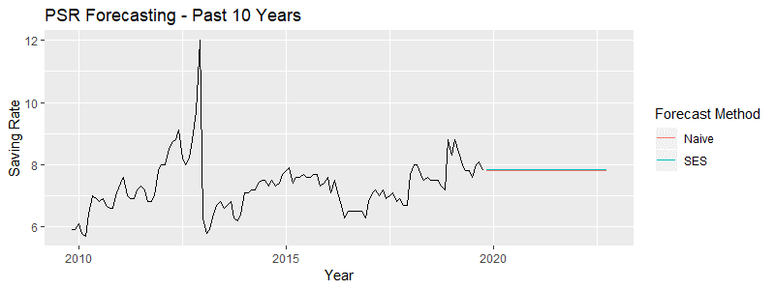
PSR Comparisons, Conclusion, and Final Remarks
Both return about the same flat forecasts
Length of data
Sudden change from 2005 -> New trend cycle?
Unexplained Random Variability
Other models/methods needed such as ARIMA
Notes:
(2m)
Comparing two methods at the same time with future forecasts, unfortunately they both return roughly the same flat forecasts. I suspect that there are two main reasons why this happened.
First is the length of data. It has more than 700 data points, and the methods that we used may have been too much affected by this. Also, notice that data could have had two different distinct trend before and after around 2005, and the new trend may not have much to do with data before 2005. Therefore, we could split the data before and after 2005 and only use data after 2005.
Second thing is that the data has quite a persistent unexplained random variability. The fact that data carries such persistent variability after seasonal adjustment may imply that we need another model that can take this into account, such as ARIMA.

